Slide 1
Constructing Mobility Futures: The Case of HS2
Murray Goulden
Robert Dingwall
Notes:
Comparative neglect of railways within mobilities work. 47 references returned by search of Mobilities but no more than 10 of these are actually addressed to aspects of rail transport and only 1 examines high-speed rail (Minns 2013). Need for more attention to rail. Major strategic objective for the EU through the Community trans-European transport network (TEN-T) programme . “The cost of implementing the entire TEN-T is estimated at around EUR 900 billion between 1996 and 2020 (4). As far as high-speed rail is concerned, 14 priority projects (5) have been launched to develop new lines and/or upgrade existing ones at a cost of some EUR 269 billion between 1996 and 2020.” A major project for the UK government as a response to critics of its short-term austerity programme.
This is based on work we did last year, which events have overtaken talk somewhat – elements of this argument have appeared increasingly in news media in recent weeks. On the one hand this is unfortunate, on the other it proves we’re on to something!

Slide 2
The Problem of Transport Futures
Transport infrastructures have a lengthy capital replacement cycle.
Critical decisions constrain mobility options for decades, even centuries.
Investment decisions commit public or private resources at the expense of possible alternatives.
Transport confronts in an acute form the general problem of stabilizing an unknown and uncertain future.

Slide 3
This is a scheme that will reshape and strengthen our country and it deserves serious debate and scrutiny […] today's transport system will not be enough for the demands of tomorrow. Hiding from that fact would leave our country weaker and poorer.
Patrick McLoughlin is secretary of state for transport
Notes:
HS2 as a case study. This is being promoted by the UK government through glossy PR with lots of bucolic imagery of trains gliding silently through virgin countryside. A Grand Project that will transform the country’s economy, promote regional development – redressing inequalities in growth and employment opportunities, free up existing tracks for transfer of freight from road and more commuter capacity. Environmentally friendly.

Slide 4
Notes:
A public subsidy to already privileged travellers. Sophistication of opposition. (return to with discussion of challenge of using future vision to sell project)

Slide 5
Government Economic Case 2010
‘Capacity’
Lack of capacity on existing network
‘Connectivity’
Journey time reductions
‘Sustainability’
Reduction in emissions
Overall benefits of ‘Well over £2 for every £1 spent’
Notes:
Main approach to stabilization is cost-benefit (or benefit-cost analysis). As the next few slides show, this has manifestly failed.
1:24 to 49m London-Birmingham
2:08 to 1:13 London-Manchester

Slide 6
Government Economic Case 2011-12
Sensitivity testing for:-
The overall level of demand
The rate of growth in travel;
The price of different modes.
Lowering of assumed growth rates reduces BCR to 1.6
2012 update: BCR falls to 1.4
Notes:
2011 document laid out the sensitivity tests ran on the model. These are intended to establish the robustness of it by testing what impact changing the key variables has on the bottom line. In light of the ongoing opposition, this can be read as an acknowledgement of uncertainty, and a weakening of the vision.
Economic case which was the cornerstone of the HS2 future has continually been eroded, but 2012 it was just 1.4. (Government classify a ‘High’ return as 2-4)

Slide 7
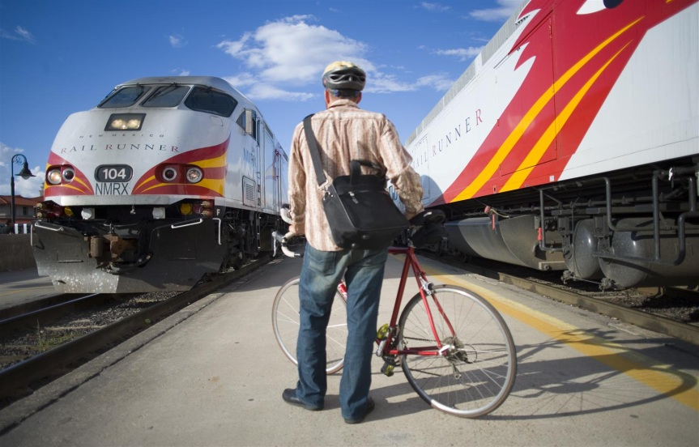
Sample Criticisms 1
Capacity
Lack of attention to alternative investments
Unrealistic demand forecasts
Lack of consideration of implications of over-capacity on pricing and demand
Notes:
These three slides are assembled from a variety of think-tanks that would not otherwise be expected to agree on much like the Institute of Economic Affairs, the New Economics Foundation
Alternatives – like multiple smaller scale rail projects, bike infrastructure in cities
Demand forecasts – “past trends do not suggest any slow down in the growth in long distance rail travel. We could therefore project positive rail growth over the whole life of the scheme. However, given how far ahead we are looking, we have taken a more cautious approach”

Slide 8
Sample Criticisms 2
Connectivity
Outdated assumptions about non-use of journey time – business customers now work on trains with their laptops!
Assumed income of passengers - £70+K per year – not a service for everyone!
Disregard of international evidence on risk of sucking growth out of regions to capital
Notes:
“A central part of the Government’s current economic case for HS2 is that time spent on a train is unproductive. However, the IoD research shows that this assumption is wildly inaccurate, as only 6 per cent of directors say they never work on a train. 48 per cent of members say they spend at least half of the journey working, 26 per cent work for between a quarter and half the time, and 21 per cent spend up to a quarter of the journey time working productively. ” Institute of Directors
£79k in top 5% of earners. Mobility for the elites - stratas

Slide 9
Sample Criticisms 3
Sustainability
“there is no potential carbon benefit in building a new line on the London to Manchester route over the 60 year appraisal period” (Booz Allen Hamilton for DFT 2007)
Notes:
CO₂ reductions from travellers switching from domestic flights to HS2 can only be realized if the airport slots that were used for domestic flights are closed. This seems unlikely in the context of calls for expanded aviation capacity.

Slide 10
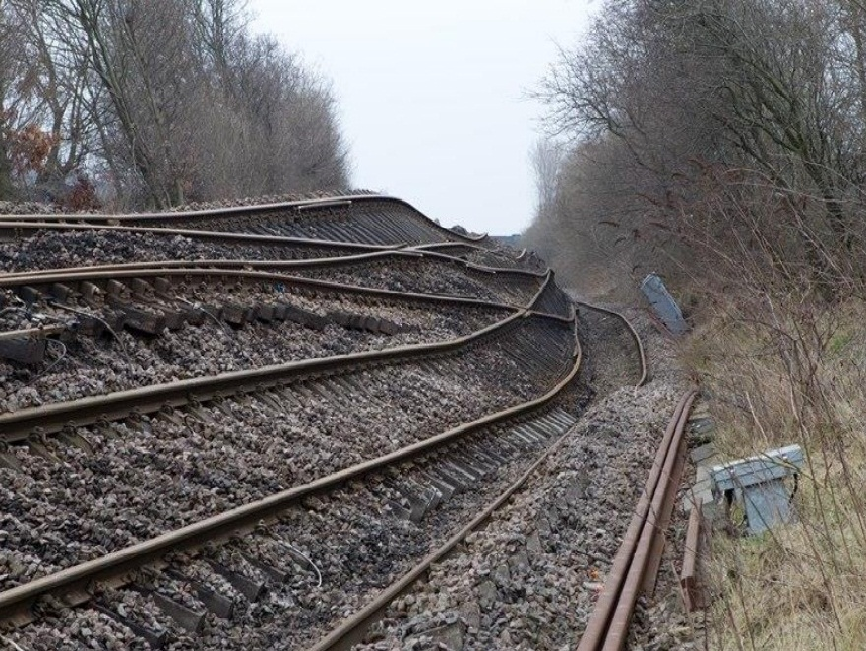
Collapsing Benefit Cost Ratio
Critics now see this as well below 1:1
Economically, the UK would actually lose on this investment.

Slide 11
National Audit Office 2013
High Speed 2 is at a very early stage of planning and development and, as such, we cannot conclude on whether the programme is likely to deliver value for money. The cost and benefit estimates in its economic case are uncertain and will change because the programme is at an early stage. Furthermore, there have been past errors in the underlying model and some key data needs to be updated. In presenting its case for investment, the Department has poorly articulated the strategic need for a transformation in rail capacity and how High Speed 2 will help rebalance economic growth. The Department and HS2 Limited have started a lot of work recently to strengthen the evidence and analysis on which the case is based. The challenging programme timetable, however, makes delivering this work difficult and increases the risks that the programme will have a weak foundation for securing and demonstrating success in the future.
Notes:
Government vision rejected. The National Audit Office is responsible to Parliament for monitoring the efficiency and effectiveness of public expenditure. Its reports vary in quality but its independence is widely respected.

Slide 12
Political attempts at stabilization
Attack NAO for using the 2011 version of the numbers
Re-do the calculations to give a better result
More Ministerial bombast
Obvious questions about relationship between evidence and policy and means of legitimating policy
Notes:
Raises question of why 2012 numbers can be trusted if 2011 can’t, give the 60 year span of the project! "We have never accepted the conclusion of the National Audit Office report and have consistently said this. The report depends too much on out-of-date analysis and does not give due credit for all the good progress that has been made in the 18 months since the business case they examined was produced. Ministers are entirely in agreement with this position and we will continue to contest the NAO's conclusion," he said.
The Ministerial bombast is on slide 2 – this is a matter of national interest and status (like Concorde). Moving away from economic justification to focus on political?

Slide 13
Modelling the Future
Policymakers have attempted to close down uncertainty through modelling
A single linear pathway based on selected past trends
Mobilizing the future requires collapsing possibility through arbitrary selection of variables
Ultimately, HS2 has been undermined by the failure of this modelling process to gain wide legitimacy
Notes:
Silo’d thinking
Opponents open the black box

Slide 14
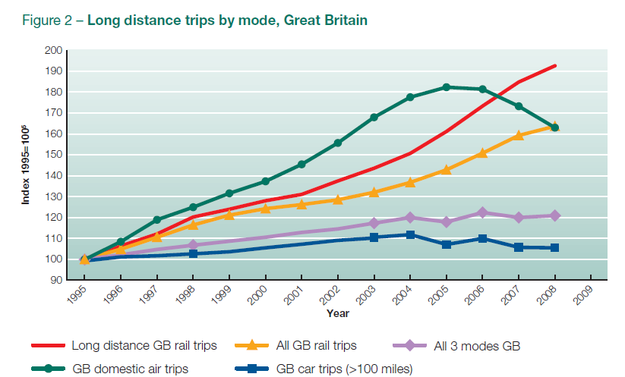
Upwards and to the Right?
Notes:
From DfT 2011. “past trends do not suggest any slow down in the growth in long distance rail travel.”
Assumption of expanding demand on basis of past history, but own data shows the decline of domestic air travel since 2005. This wasn’t due to any variables DfT even consider – not a declining economy, or falling population, or even environment concerns of travellers. This the result of political responses to Sept 11th 2001, itself part drive by media responses to that event. New security requirements on domestic flights greatly increased the journey time relative to other modes.
Perfect example of the weakness of these models, whatever their sophistication. Mobilities are tightly intertwined with the society in which they occur.

Slide 15
Need for a Mobilities perspective
Story about the complexities of mobility escaping the straightjacket of modellers’ future
What is the mobility problem to which HS2 is the answer?
How is this embedded in a future vision of UK economy and society in 2030 and beyond?
How does this relate to other technologies?
Notes:
Mobility problem? Responding to inevitable demand? Feeding economic growth? Or is it mobility as demanded by national pride?

Slide 16
A Mobilities approach?
More substantial public dialogue over long-term futures
Holistic review of movement problems
Competing technologies which might reconfigure practices away from rail travel?
Digital economy
3D printing
Autonomous cars, “road trains”
Notes:
The first of these is about the diversity of futures and a consensus about what we are trying to achieve rather than something that suits a narrow set of London-oriented stakeholders.
The second – doesn’t rely on mode specific planning each within their own silo. Rather than focus on gross measures of cost-benefit ration it might concern itself with questions of how benefits are felt. If HS2 does boost GDP, but exacerbates North South divide is that positive?
The third is to note that these are all competitors for mobility that are here now and realistically likely to have an impact over the next 30 years. Digital economy is another big public investment in having everyone work in a distributed fashion – at least in many professional and service industries. 3D printing is probably being overhyped in domestic terms and will still need bulk feedstocks to be moved around but it will have a big impact on businesses that need stockholding of replacement acomponents for machinery, for example. Autonomous cars fuelled by alternative fuels, perhaps travelling as co-ordinted ‘road trains’ could take demand away from inflexible rail.

Slide 17
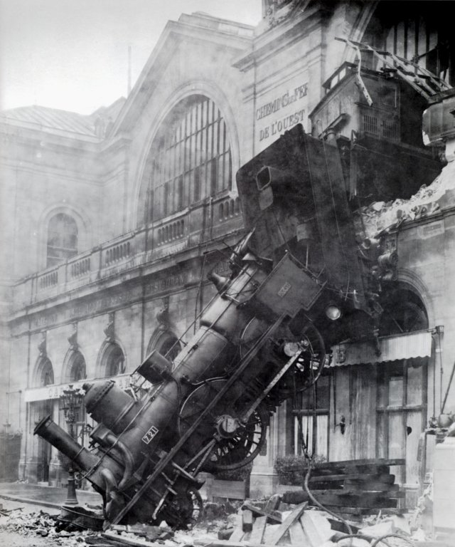
Challenges of Transport Planning
“which practices currently demanding mobility might not exist in the future?”
Do we need a Department of Mobility rather than Department of Transport?
Notes:
Shove: “which practices currently demanding mobility might not exist in the future?”

Slide 18
Constructing Mobility Futures: The Case of HS2
Murray Goulden
University of Nottingham
Robert Dingwall
Dingwall Enterprises
Funding from EPSRC FUTURENET and RCUK Digital Economy
Notes:
Comparative neglect of railways within mobilities work. 47 references returned by search of Mobilities but no more than 10 of these are actually addressed to aspects of rail transport and only 1 examines high-speed rail (Minns 2013). Need for more attention to rail. Major strategic objective for the EU through the Community trans-European transport network (TEN-T) programme . “The cost of implementing the entire TEN-T is estimated at around EUR 900 billion between 1996 and 2020 (4). As far as high-speed rail is concerned, 14 priority projects (5) have been launched to develop new lines and/or upgrade existing ones at a cost of some EUR 269 billion between 1996 and 2020.” A major project for the UK government as a response to critics of its short-term austerity programme

